Slide 1

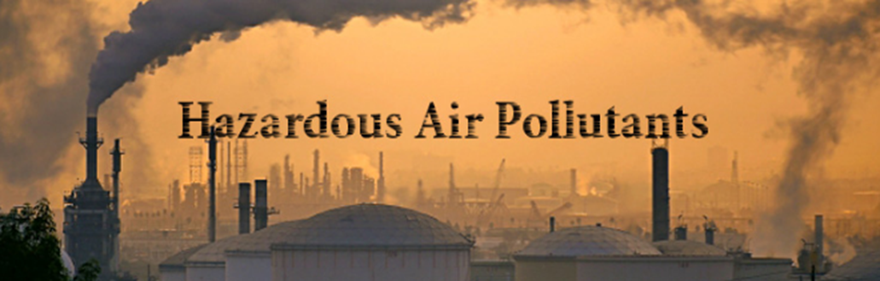

Slide 2

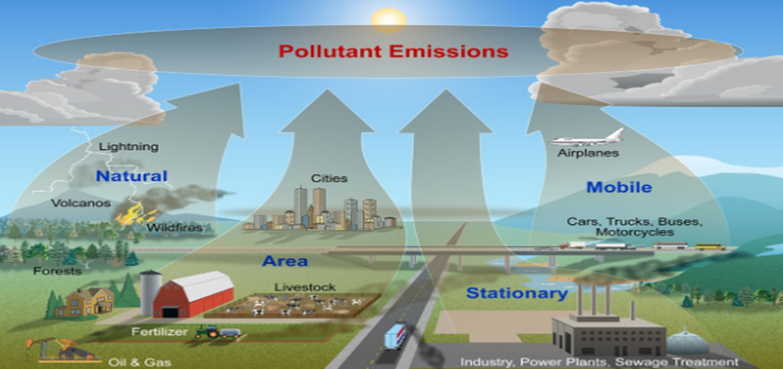

Slide 3
CONTENTS
Introduction
Dataset Specification
System Specification
Work Flow
Creation of Table Query
Visualization
Insights
GitHub
Reference

Slide 4
INTRODUCTION
Environmental Protection Agency (EPA)
The mission of the EPA to protect and conserve the natural environment and improve the health of humans by researching the effects of and mandating limits on the use of pollutants. The EPA regulates the manufacturing, processing, distribution and use of chemicals and other pollutants.
In this project, we focus on analyzing the hazardous air pollutants that were emitted between the year 1990 to 2017.

Slide 5
DATA SPECIFICATION
Data Source URL
https://www.kaggle.com/epa/hazardous-air-pollutants/data
Data Set
Hazardous air pollutant data
Data Size
2.3 GB
Format
CSV

Slide 6
SYSTEM SPECIFICATION
Oracle Big Data Compute Edition: 5 nodes
OCPUs: 10
Memory: 150 GB
Storage: 678 GB
HDFS Capacity: 147 GB

Slide 7
WORK FLOW
Data Acquisition
Used Kaggle to acquire dataset
ETL using Hive Used Hive to perform extract, load, transform the data
Visualization Used Power BI for visualization
Desktop to Local directory Used WINSCP to copy the dataset

Slide 8
Creation of Table Query
CREATE TABLE IF NOT EXISTS airpollution
(state_code DECIMAL, county_code DECIMAL, site_num DECIMAL, parameter_code DECIMAL, poc DECIMAL,
latitude DECIMAL (10,6), longitude DECIMAL (10,6), datum string, parameter_name string, sample_duration string, pollutant_standard string, date_local date, units_of_measure string, event_type string, observation_count DECIMAL, observation_percent DECIMAL, arithmetic_mean DECIMAL, first_max_value float, first_max_hour float, aqi string, method_code DECIMAL, method_name string, local_site_name string, address string, state_name string, county_name string, city_name string, cbsa_name string, date_of_last_change date)
ROW FORMAT DELIMITED FIELDS TERMINATED BY ','
STORED AS TEXTFILE LOCATION '/user/slnu2/airpollution1/epa_hap_daily_summary'
TBLPROPERTIES ('skip.header.line.count'='1');

Slide 9
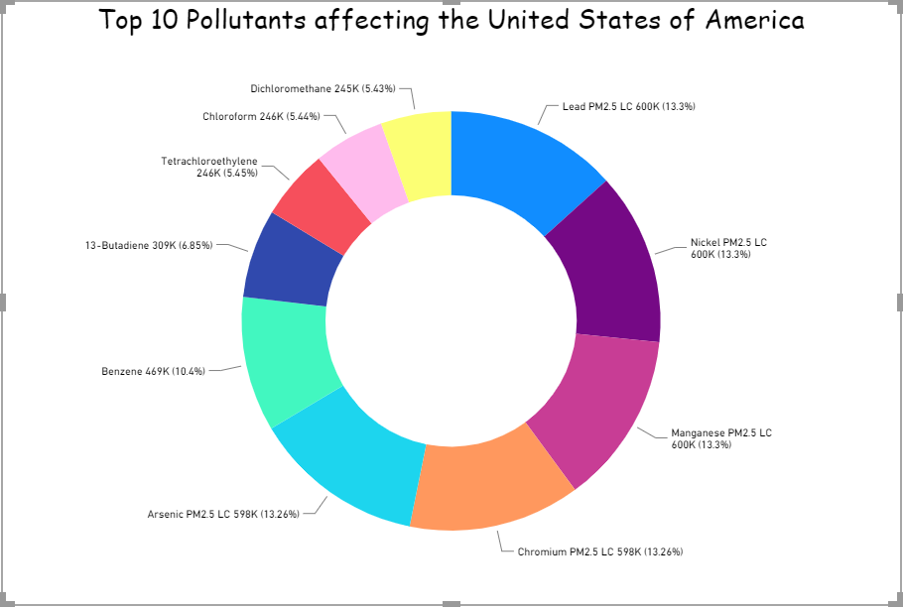
VISUALIZATION

Slide 10
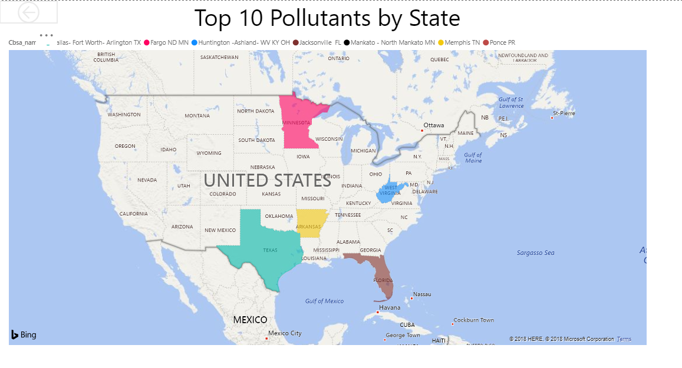

Slide 11
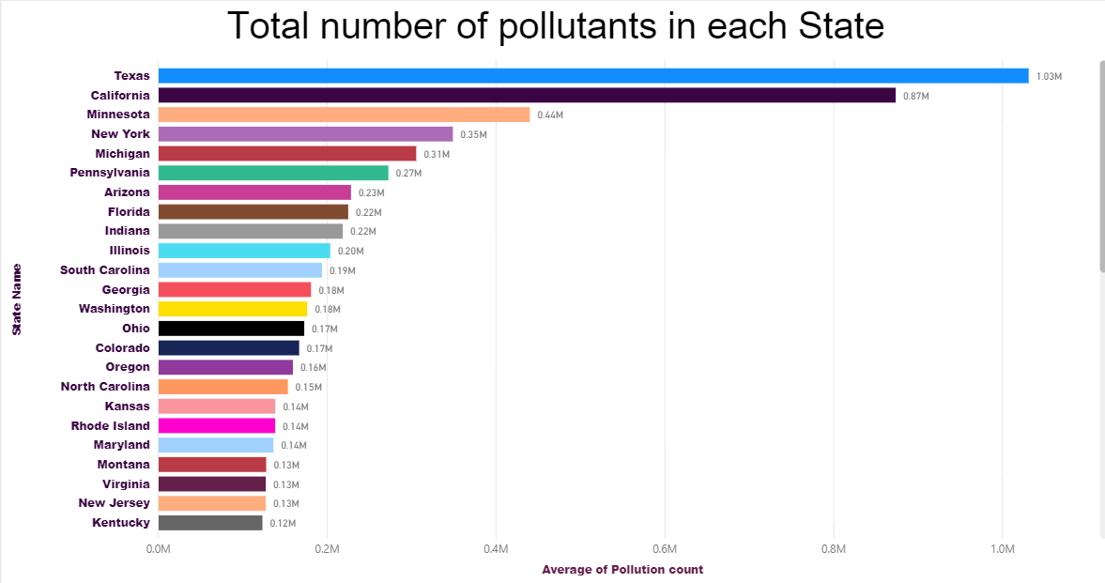

Slide 12
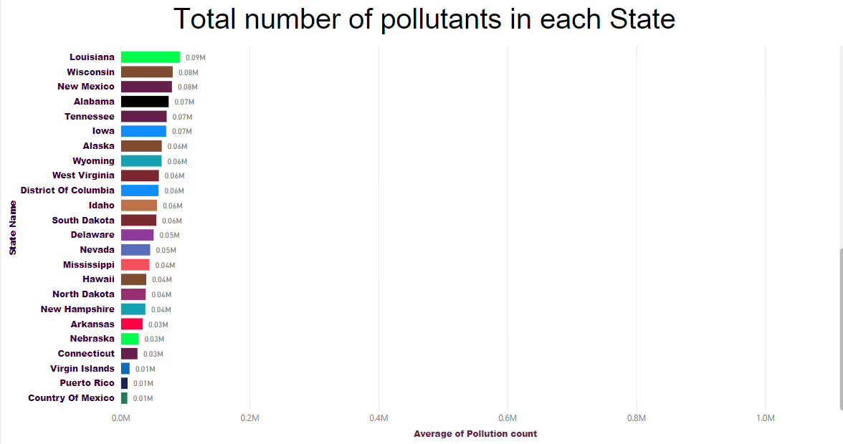

Slide 13
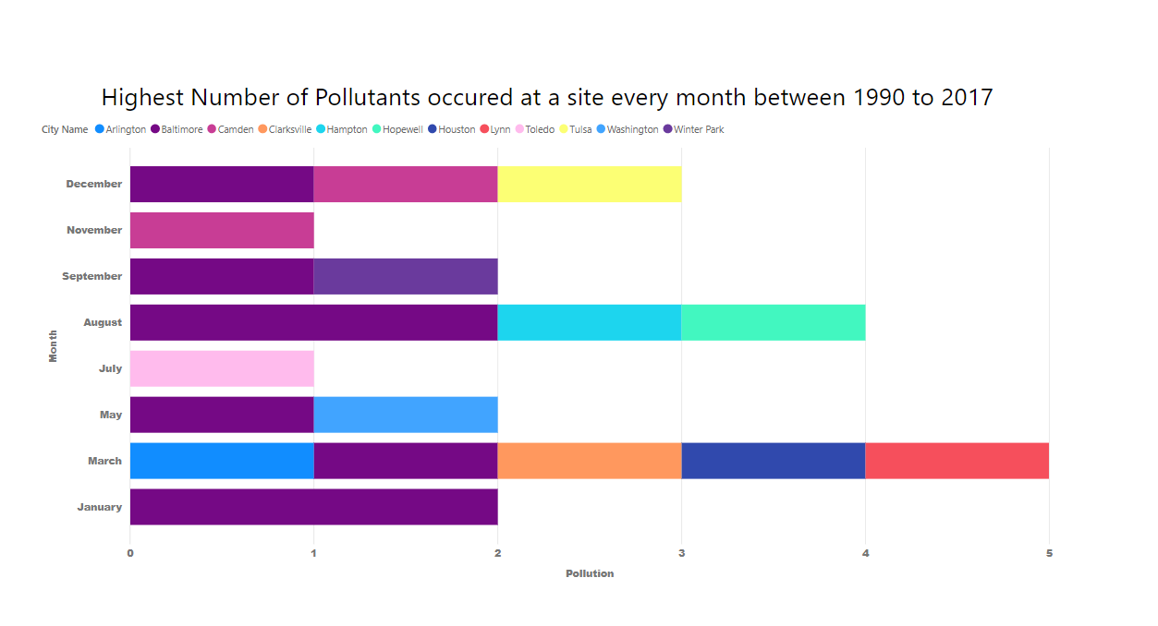

Slide 14
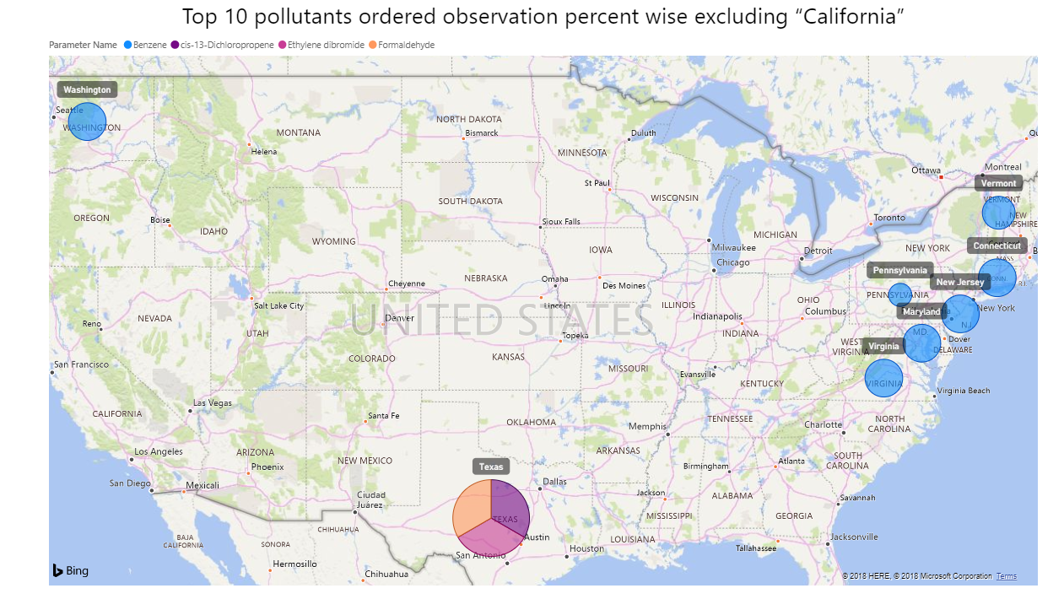

Slide 15
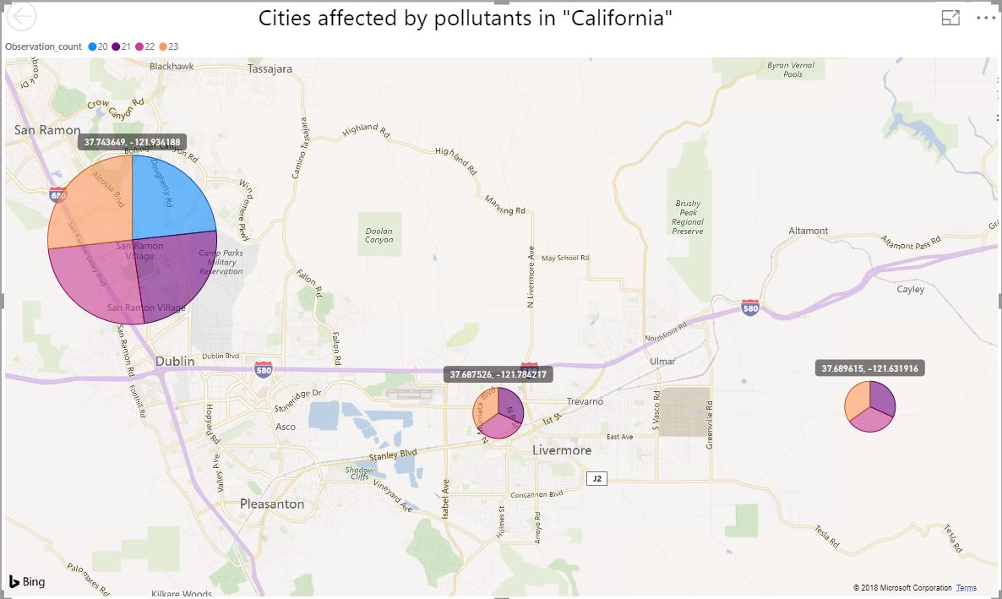

Slide 16
INSIGHTS
Lead PM2.5, Chromium PM2.5 LC and Arsenic PM 2.5 LC are the most hazardous pollutants affecting USA since 1990 to 2017.
These pollutants are mostly emitted from Texas, Minnesota, Arkansas, Florida & West Virginia.
Highest(1 million+) pollutants are emitted from the state of Texas where as the least (0.01million) pollutants are emitted from Virgin Islands.
In “California”, San Ramon & Livermore affected the most by toxic pollutants.
The sites and date’s where the lowest and highest levels of air pollution occurred. Eg. Smoke from Chimney or an electrical transformer blasts etc..

Slide 17


Slide 18
REFERENCES
https://www.kaggle.com/epa/hazardous-air-pollutants/data
http://hive.apache.org/
https://app.powerbi.com
Lab Tutorial from CIS 5200
Classmate: Monica Mishra

